Slide 1
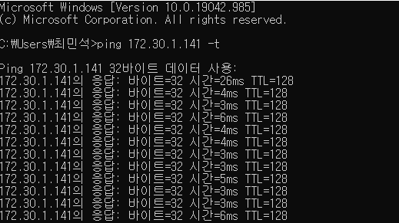


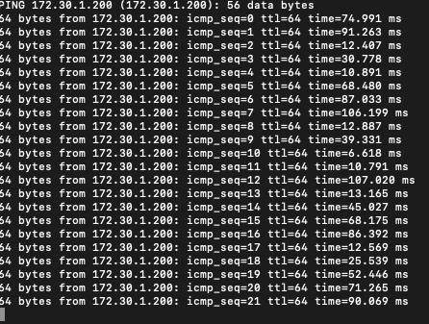
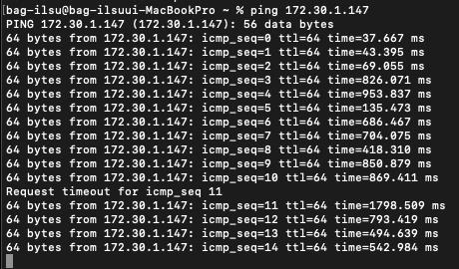
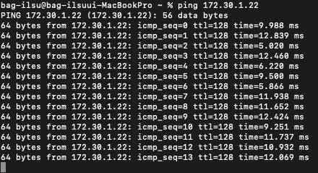
[Windows OS] - to – [Windows OS]
[Windows OS] - to – [Android]
[Windows OS] - to – [Mac OS]
[Mac OS] - to – [Mac OS]
[Mac OS] - to – [Android]
[Mac OS] - to – [Windows OS]

